Slide 1
L3 Field Effect Transistors

Slide 2
FET ( Field Effect Transistor)
Few important advantages of FET over conventional Transistors
1. Unipolar device i.e. operation depends on only one type of charge carriers (h or e)
2. Voltage controlled Device (gate voltage controls drain current)
3. Very high input impedance (≈10⁹-10¹² Ω)
4. Source and drain are interchangeable in most Low-frequency applications
5. Low Voltage Low Current Operation is possible (Low-power consumption)
6. Less Noisy as Compared to BJT
7. No minority carrier storage (Turn off is faster)
8. Self limiting device
9. Very small in size, occupies very small space in ICs
10. Low voltage low current operation is possible in MOSFETS
11. Zero temperature drift of out put is possible

Slide 3
Types of Field Effect Transistors (The Classification)
JFET
MOSFET(IGFETs) insulated-gate field-effect transistors
n-Channel JFET
p-Channel JFET
FET
Enhancement MOSFET
Depletion MOSFET
n-Channel EMOSFET
p-Channel EMOSFET
n-Channel DMOSFET
p-Channel DMOSFET

Slide 4
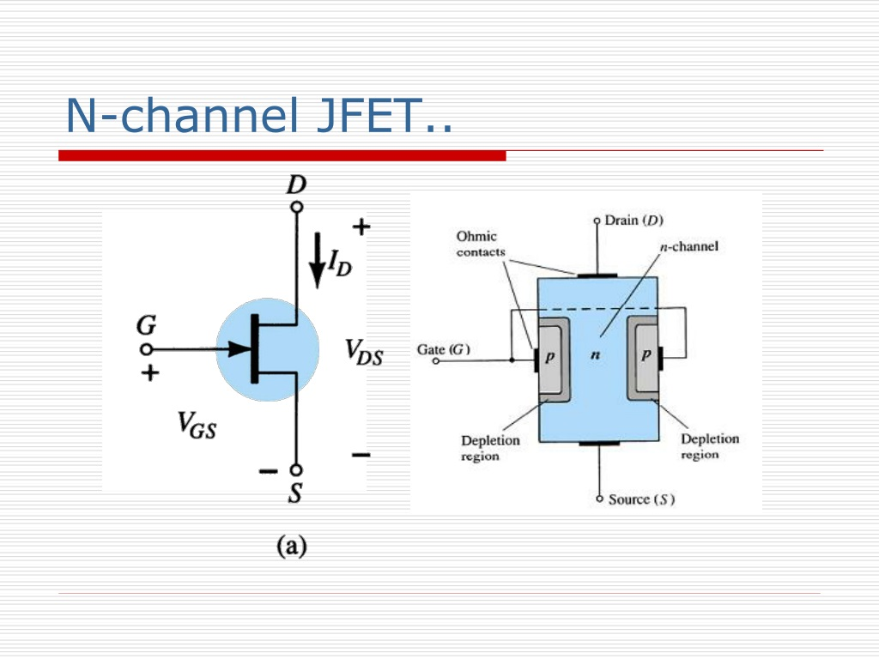

Slide 5
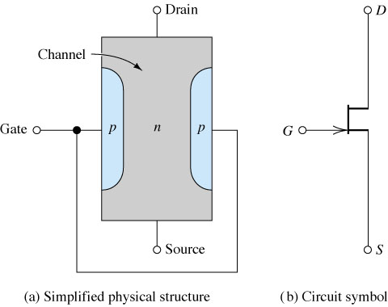
The Junction Field Effect Transistor (JFET)
Figure: n-Channel JFET.

Slide 6
SYMBOLS
Drain
Drain
Gate
Gate
Source
Source
n-channel JFET
p-channel JFET

Slide 7
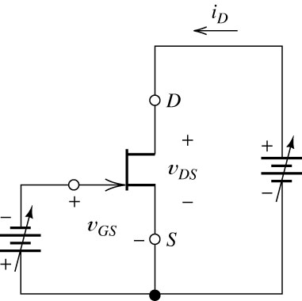
Biasing the JFET
Figure: n-Channel JFET and Biasing Circuit.

Slide 8
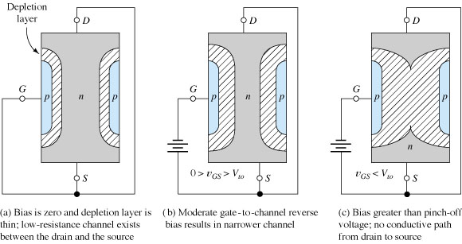
Operation of JFET at Various Gate Bias Potentials
Figure: The nonconductive depletion region becomes broader with increased reverse bias.
(Note: The two gate regions of each FET are connected to each other.)

Slide 9
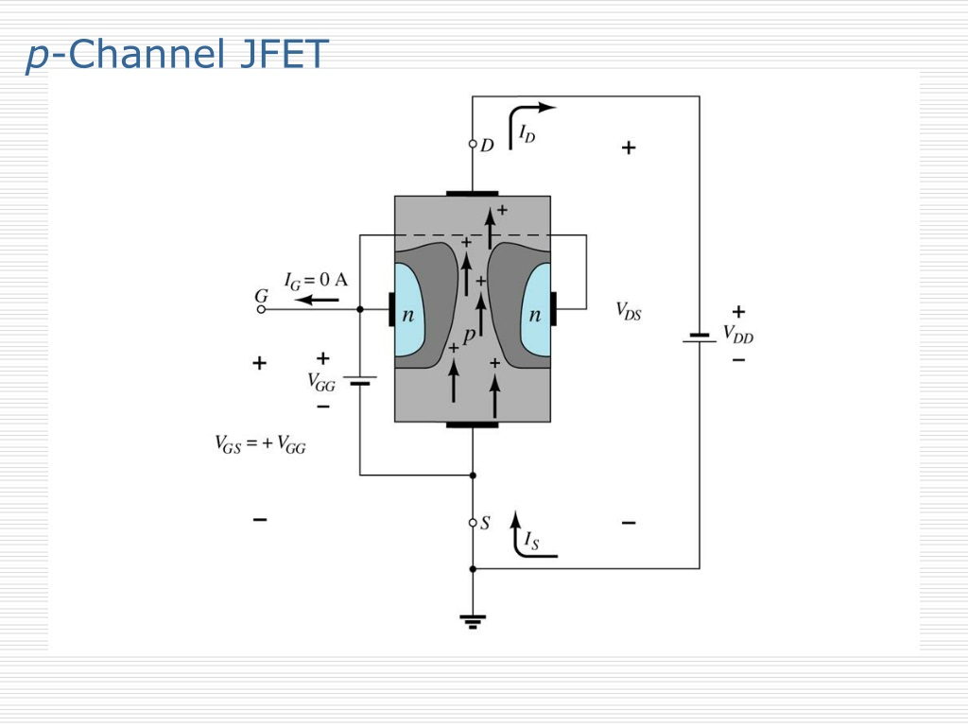

Slide 10
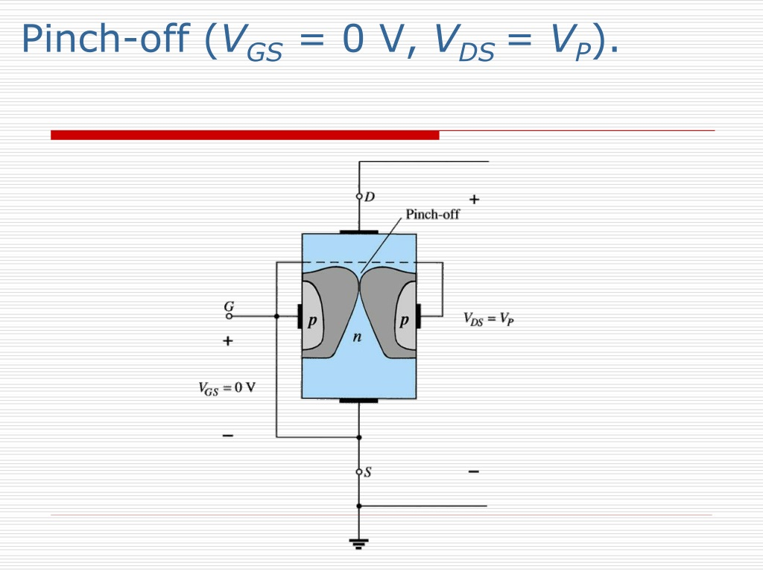

Slide 11
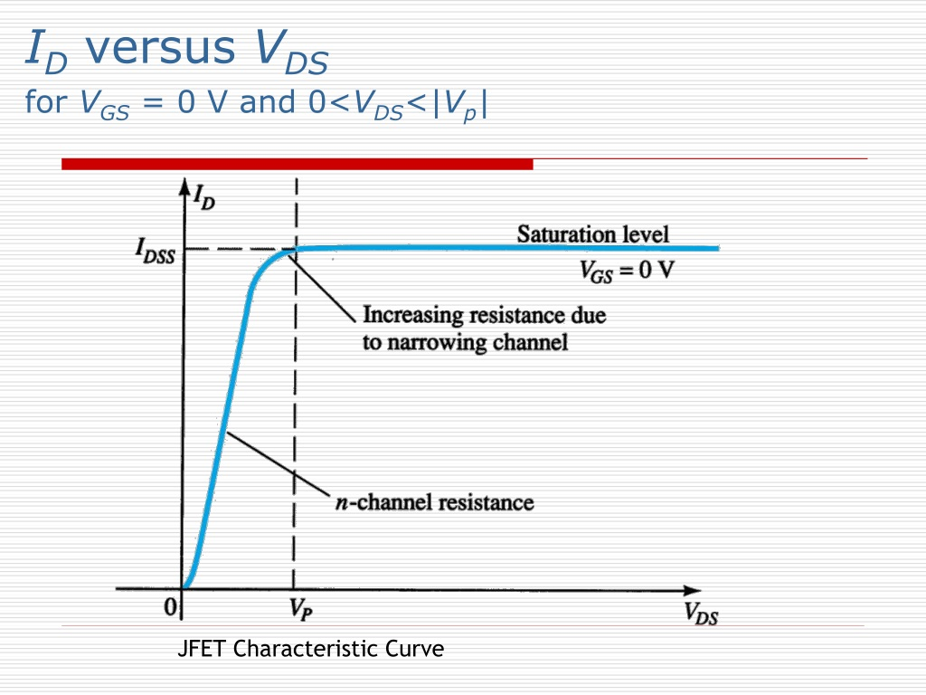

Slide 12
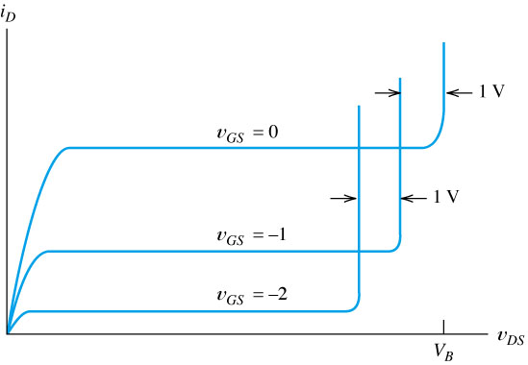
N-Channel JFET Characteristics and Breakdown
Break Down Region
Figure: If v_{DG} exceeds the breakdown voltage V_{B}, drain current increases rapidly.

Slide 13
Pinch off Voltage
As we continue to increase the reverse bias of gate terminal the depletion layer widens and a point is reached where entire channel is filled with depletion layer and drain current will be reduced to zero except for small reverse saturation currents order of nano amperes. The gate to source voltage at which at which the entire channel will be depleted of charge carrier is called pinch-off voltage.

Slide 14
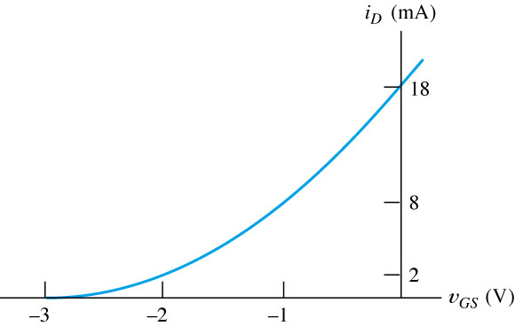
Transfer (Mutual) Characteristics of n-Channel JFET
I_{DSS}
V_{GS (off)}=V_{P}
Figure: Transfer (or Mutual) Characteristics of n-Channel JFET
V_{GS (off)} (channel complete cutoff ,the ID=0)

Slide 15
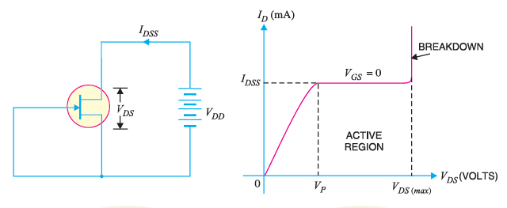
(i) Since IDSS is measured under shorted gate conditions, it is the maximum drain current that you can get with normal operation of JFET.
(ii) There is a maximum drain voltage [VDS (max)] that can be applied to a JFET. If the drain voltage exceeds VDS (max), JFET would breakdown as shown in above fig
(iii) The region between VP and VDS (max) (breakdown voltage) is called constant-current region or active region. As long as VDS is kept within this range, ID will remain constant for a constant value of VGS. In other words, in the active region, JFET behaves as a constant–current device. For proper working of JFET, it must be operated in the active region.

Slide 16
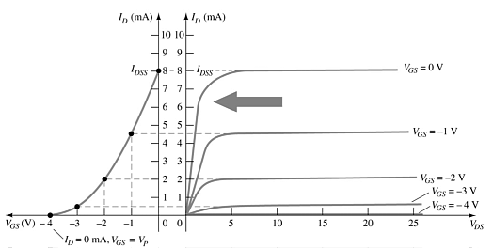
JFET Transfer Curve This graph shows the value of I_{D} for a given value of V_{GS}

Slide 17
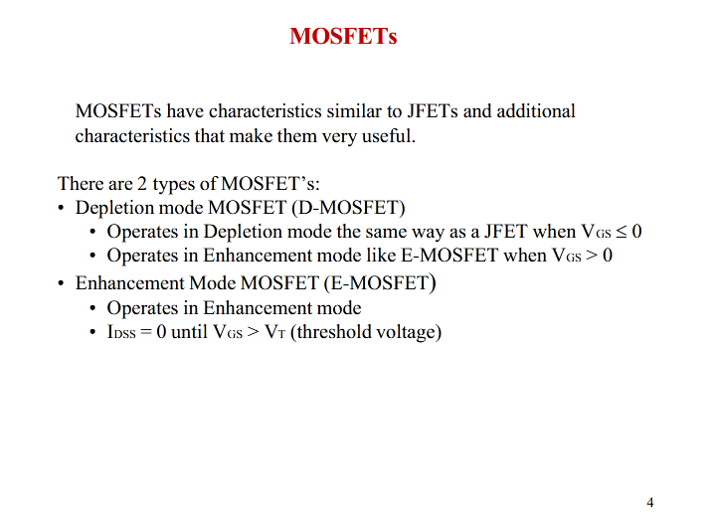
One of the most important physical parameters of a MOSFET is its threshold voltage V _{th} defined as the gate voltage at which the device starts to turn on

Slide 18
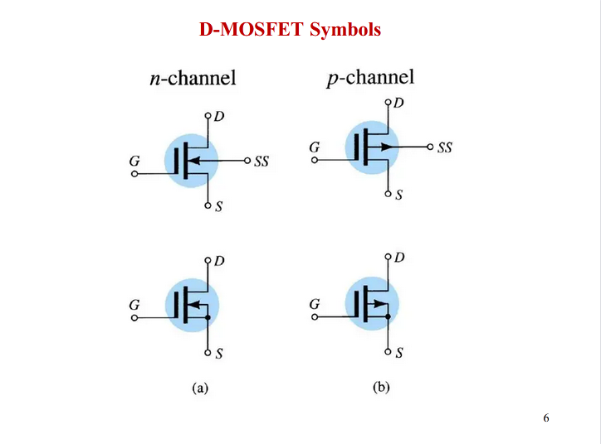

Slide 19
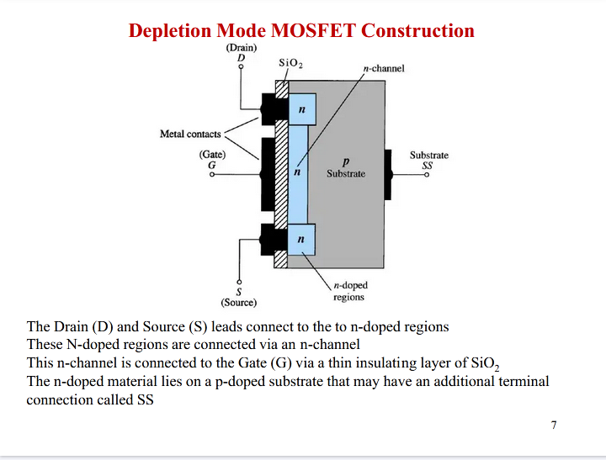

Slide 20
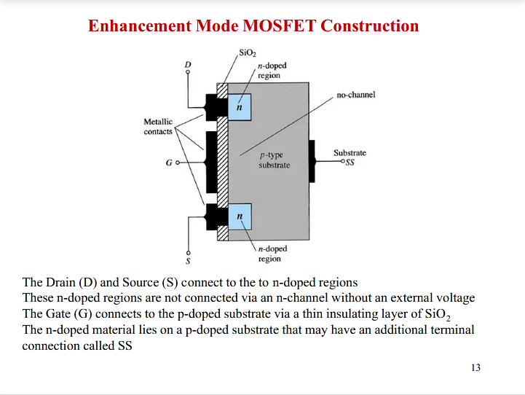

Slide 21
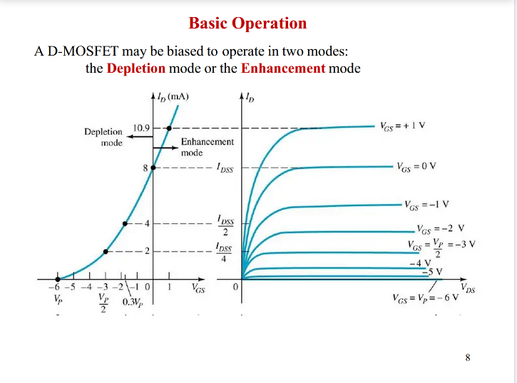

Slide 22
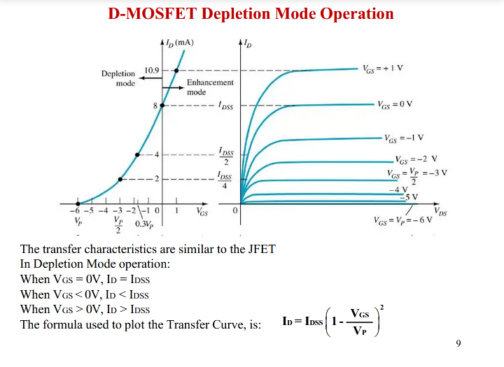

Slide 23
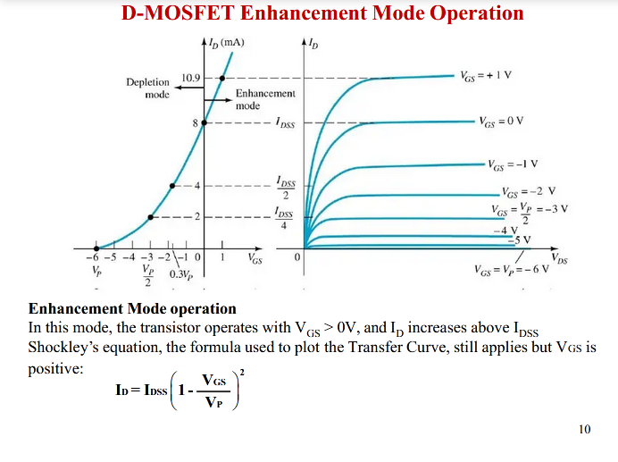

Slide 24
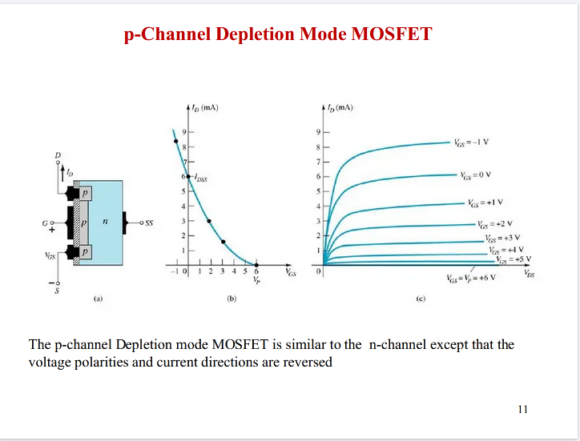

Slide 25
MOSFET
Operation
gate volt controls the thickness of the channel
consider an n-channel device
making the gate more positive attracts electrons to the gate and makes the gate region thicker – reducing the resistance of the channel. The channel is said to be enhanced
making the gate more negative repels electrons from the gate and makes the gate region thinner – increasing the resistance of the channel. The channel is said to be depleted

Slide 26


Slide 27
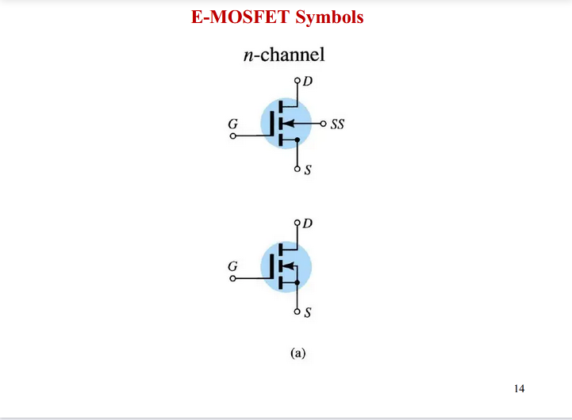

Slide 28
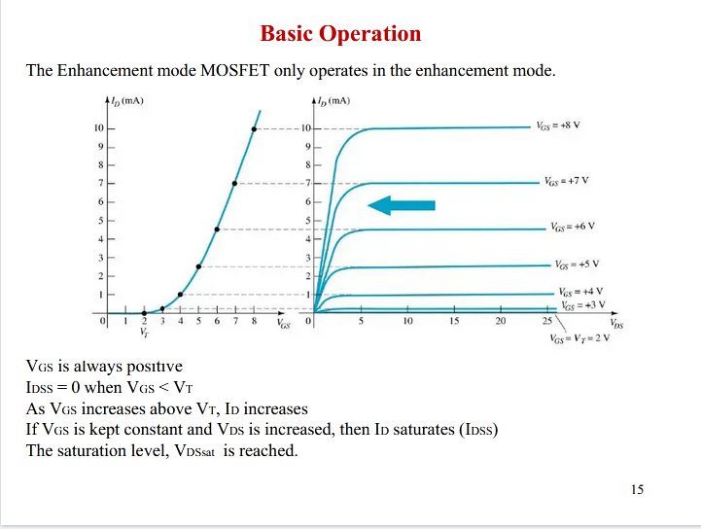

Slide 29
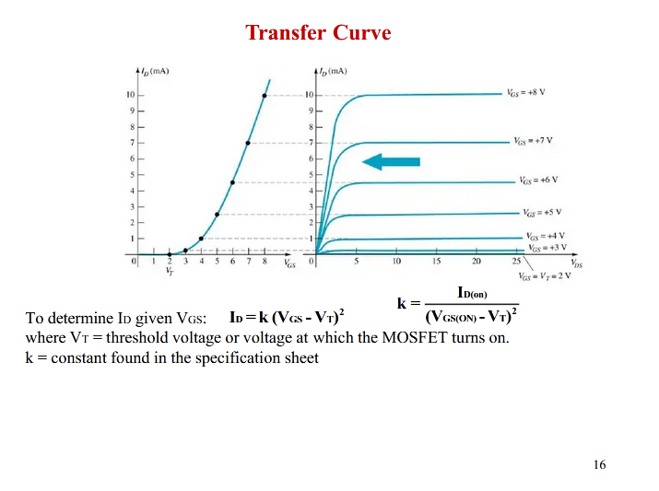

Slide 30
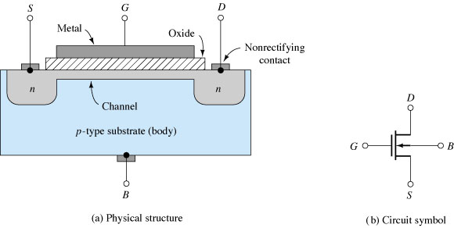
Figure n-Channel depletion MOSFET.

Slide 31
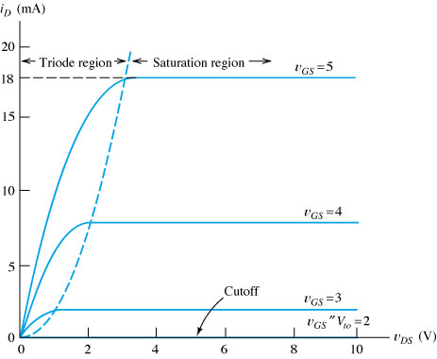
Figure Characteristic curves for an NMOS transistor.

Slide 32
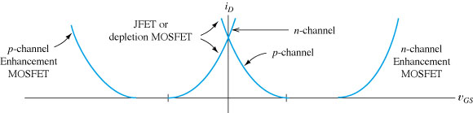
Figure Drain current versus v_{GS} for several types of FETs. i_{D} is referenced into the drain terminal
for n-channel devices and out of the drain for p-channel devices.

Slide 33
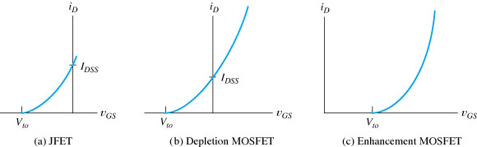
Figure Drain current versus v_{GS} in the saturation region for n-channel devices.

Slide 34
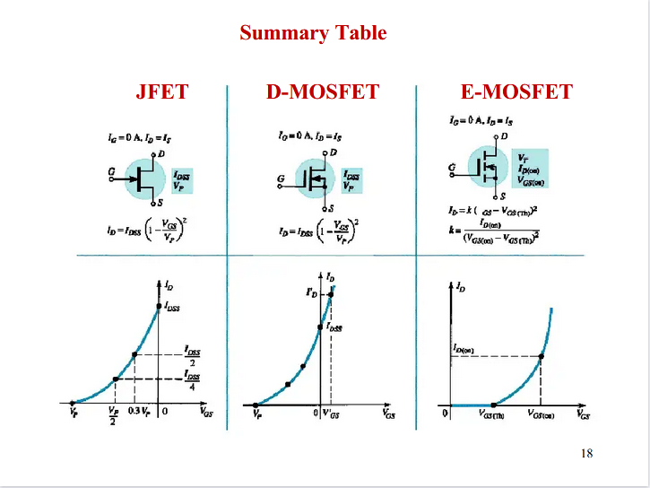
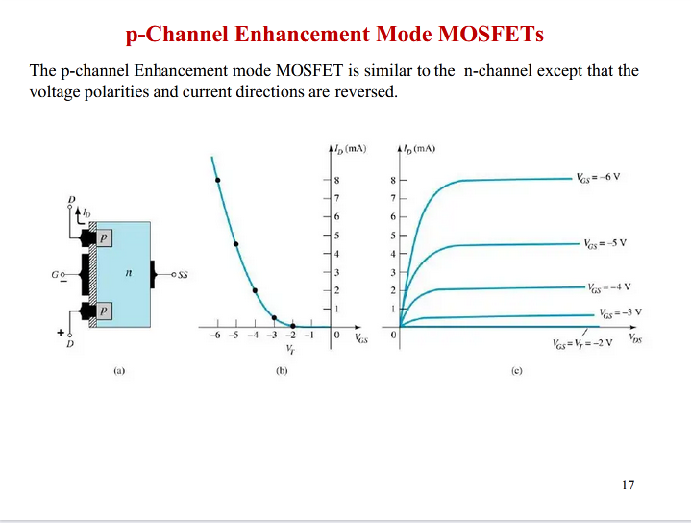

Slide 35
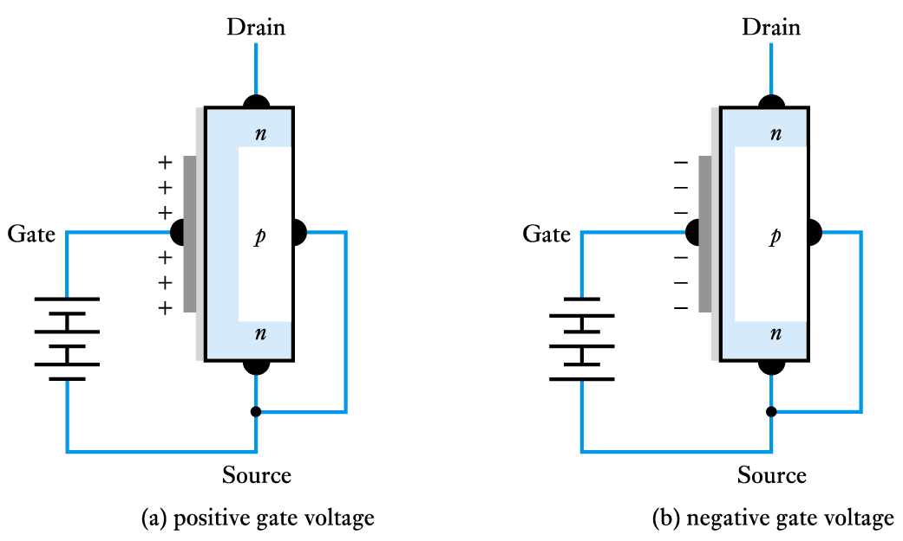
the effect of varying the gate voltage

Slide 36
Biasing Circuits used for JFET
Fixed bias circuit
Self bias circuit
Potential Divider bias circuit

Slide 37
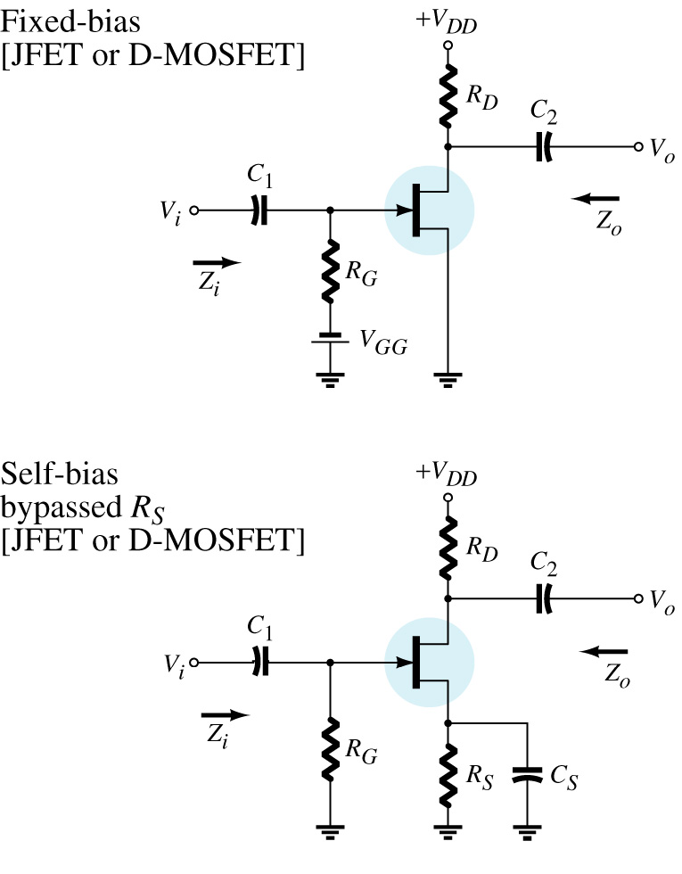
JFET (n-channel) Biasing Circuits
For Fixed Bias Circuit
Applying KVL to gate circuit we get
and
Where, V_{p}=V_{GS-off} & I_{DSS} is Short ckt. I_{DS}
For Self Bias Circuit

Slide 38
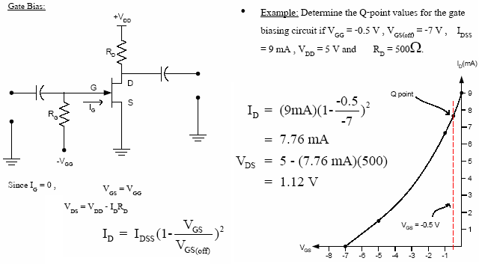
JFET Biasing Circuits Count…
or Fixed Bias Ckt.

Slide 39
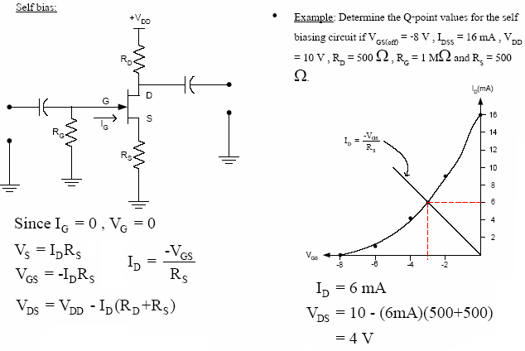
JFET Self (or Source) Bias Circuit
This quadratic equation can be solved for V_{GS} & I_{DS}

Slide 40
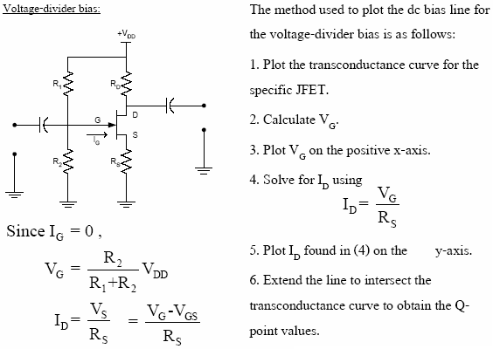
The Potential (Voltage) Divider Bias

Slide 41
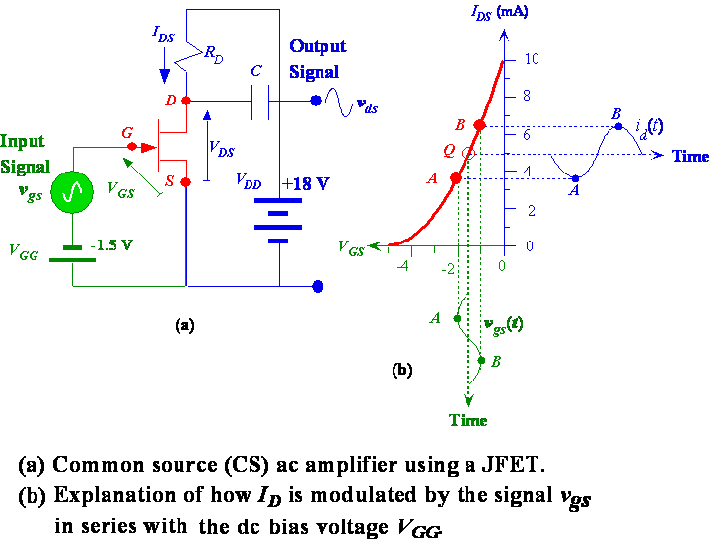
A Simple CS Amplifier and Variation in I_{DS} with V_{gs}

Slide 42
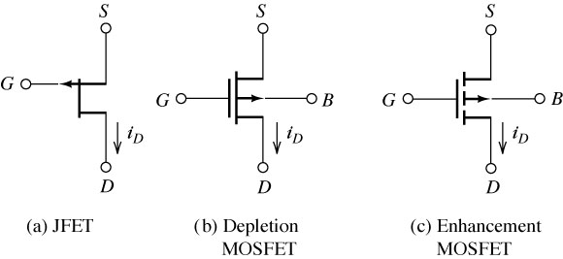
Figure p-Channel FET circuit symbols. These are the same as the circuit symbols for n-channel devices,
except for the directions of the arrowheads.

Slide 43
A bipolar junction transistor (BJT) is a current controlled device i.e., output characteristics of the
device are controlled by base current and not by base voltage. However, in a field effect transistor
(FET), the output characteristics are controlled by input voltage (i.e., electric field) and not by input
current. This is probably the biggest difference between BJT and FET. There are two basic types of field effect transistors:
(i) Junction field effect transistor (JFET)
(ii) Metal oxide semiconductor field effect transistor (MOSFET)

Slide 44
Constructional details. A JFET consists of a p-type or n-type silicon bar containing two pn
junctions at the sides as shown in Fig.19.1. The bar forms the conducting channel for the charge
carriers. If the bar is of n-type, it is called n-channel JFET as shown in Fig.1
and if the bar is of p-type, it is called a p-channel JFET as shown in Fig.1
(ii). The two pn junctions forming diodes are connected *internally and a common terminal called gate is taken out. Other terminals are source and drain taken out from the bar as shown. Thus a JFET has essentially three terminals viz., gate (G), source (S) and drain (D).

Slide 45
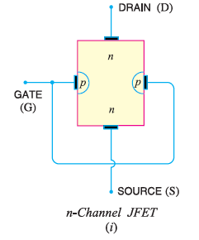
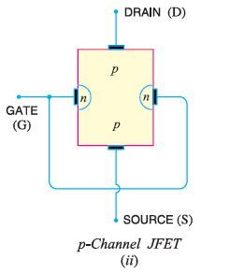
Fig 1

Slide 46
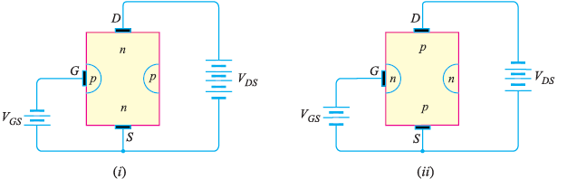
JFET polarities. Fig.2 (i) shows n-channel JFET polarities whereas Fig. 2 (ii) shows the
p-channel JFET polarities. Note that in each case, the voltage between the gate and source is such that the gate is reverse biased. This is the normal way of JFET connection. The drain and source terminals are interchangeable i.e.,either end can be used as source and the other end as drain.
Fig.2

Slide 47
The following points may be noted :
(i) The input circuit (i.e. gate to source) of a JFET is reverse biased. This means that the device
has high input impedance.
(ii) The drain is so biased w.r.t. source that drain current ID flows from the source to drain.
(iii) In all JFETs, source current IS is equal to the drain current i.e. IS = ID.

Slide 48
Principle and Working of JFET
Fig.3 shows the circuit of n-channel JFET with normal polarities. Note that the gate is reverse biased.
Principle. The two pn junctions at the sides form two depletion layers. The current conduction by
charge carriers (i.e. free electrons in this case) is through the channel between the two depletion layers and out of the drain. The width and hence *resistance of this channel can be controlled by changing the input voltage VGS. The greater the reverse voltage VGS, the wider will be the depletion layers and narrower will be the conducting channel. The narrower channel means greater resistance and hence source to drain current decreases. Reverse will happen should VGS decrease. Thus JFET operates on the principle that width and hence resistance of the conducting channel can be varied by changing the reverse voltage VGS. In other words, the magnitude of drain current (ID) can be changed by altering VGS.

Slide 49
Working. The working of JFET is as under :
(i) When a voltage VDS is applied between drain and source terminals and voltage on the gate is
zero [ See Fig. 19.3 (i) ], the two pn junctions at the sides of the bar establish depletion layers. The electrons will flow from source to drain through a channel between the depletion layers. The size of these layers determines the width of the channel and hence the current conduction through the bar.
(ii) When a reverse voltage VGS is applied between the gate and source [See Fig.3 (ii)], thewidth of the depletion layers is increased. This reduces the width of conducting channel, thereby increasing the resistance of n-type bar. Consequently, the current from source to drain is decreased.
On the other hand, if the reverse voltage on the gate is decreased, the width of the depletion layers also decreases. This increases the width of the conducting channel and hence source to drain current.

Slide 50
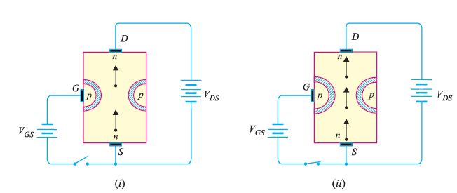
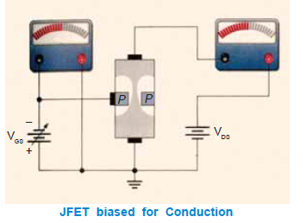
Fig.3

Slide 51
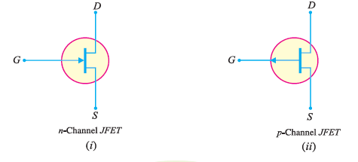
current from source to drain can be
controlled by the application of potential
(i.e. electric field) on the gate. For this
reason, the device is called field effect
transistor. It may be noted that a p-channel
JFET operates in the same manner as
an n -channel JFET except that channel
current carriers will be the holes instead
of electrons and the polarities of VGS and
VDS are reversed.
Note. If the reverse voltage VGS on the
gate is continuously increased, a state is
reached when the two depletion layers touch
each other and the channel is cut off. Under
such conditions, the channel becomes a nonconductor

Slide 52
Difference Between JFET and Bipolar Transistor
The JFET differs from an ordinary or bipolar transistor in the following ways :
(i) In a JFET, there is only one type of carrier, holes in p-type channel and electrons in n-type
channel. For this reason, it is also called a unipolar transistor. However, in an ordinary transistor, both holes and electrons play part in conduction. Therefore, an ordinary transistor is sometimes called a bipolar transistor.
(ii) As the input circuit (i.e., gate to source) of a JFET is reverse biased, therefore, the device
has high input impedance. However, the input circuit of an ordinary transistor is forward biased and hence has low input impedance.
(iii) The primary functional difference between the JFET and the BJT is that no current (actually,
a very, very small current) enters the gate of JFET (i.e. IG = 0A). However, typical BJT base current
might be a few μA while JFET gate current a thousand times smaller [See Fig. 4].

Slide 53
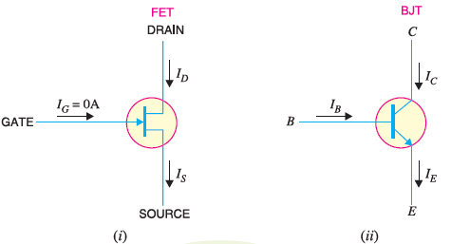
Fig 4

Slide 54
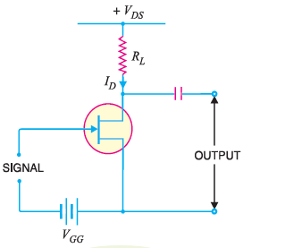
JFET as an Amplifier
Fig. 5 shows JFET amplifier circuit. The weak signal
is applied between gate and source and amplified
output is obtained in the drain-source circuit. For the
proper operation of JFET, the gate must be negative
w.r.t. source i.e., input circuit should always be reverse
biased. This is achieved either by inserting a battery
VGG in the gate circuit or by a circuit known as biasing circuit. In the present case, we are providing biasing by the battery VGG.
A small change in the reverse bias on the gate produces a large change in drain current. This fact makes JFET capable of raising the strength of a weak signal. During the positive half of signal, the reverse bias on the gate decreases. This increases the channel width and hence the drain current.
During the negative half-cycle of the signal, the reverse voltage on the gate increases. Consequently, the drain current decreases. The result is that a small change in voltage at the gate produces a large change in drain current. These large variations in drain current produce large output across the load
RL. In this way, JFET acts as an amplifier.
Fig 5

Slide 55
Output Characteristics of JFET
The curve between drain current (ID) and drain-source voltage (VDS ) of a JFET at constant gatesource
voltage (VGS) is known as output characteristics of JFET. Fig. 5 shows the circuit for determining the output characteristics of JFET. Keeping VGS fixed at some value, say 1V, the driansource voltage is changed in steps. Corresponding to each value of VDS, the drain current ID is noted. A plot of these values gives the output characteristic of JFET at VGS = 1V. Repeating similar procedure, output characteristics at other gate-source voltages can be drawn. Fig. 6 shows a family of
output characteristics.

Slide 56
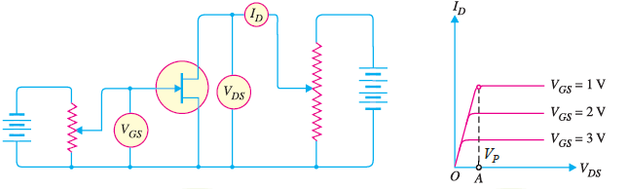
Fig 6
The following points may be noted from the characteristics :
(i) At first, the drain current ID rises rapidly with drain-source voltage VDS but then becomes constant. The drain-source voltage above which drain current becomes constant is known as pinch off voltage. Thus in Fig. 6, OA is the pinch off voltage VP.
(ii) After pinch off voltage, the channel width becomes so narrow that depletion layers almost touch each other. The drain current passes through the small passage between these layers. Therefore, increase in drain current is very small with VDS above pinch off voltage. Consequently, drain current remains constant.
(iii) The characteristics resemble that of a pentode valve.

Slide 57
Salient Features of JFET
The following are some salient features of JFET :
(i) A JFET is a three-terminal voltage-controlled semiconductor device i.e. input voltage controls the output characteristics of JFET.
(ii) The JFET is always operated with gate-source pn junction *reverse biased.
(iii) In a JFET, the gate current is zero i.e. IG = 0A.
(iv) Since there is no gate current, ID = IS.
(v) The JFET must be operated between VGS and VGS (off). For this range of gate-to-source voltages, ID will vary from a maximum of IDSS to a minimum of almost zero.
(vi) Because the two gates are at the same potential, both depletion layers widen or narrow down by an equal amount.
(vii) The JFET is not subjected to thermal runaway when the temperature of the device increases.
(viii) The drain current ID is controlled by changing the channel width.
(ix) Since JFET has no gate current, there is no β rating of the device. We can find drain current

Slide 58
Important Terms
In the analysis of a JFET circuit, the following important terms are often used :
1. Shorted-gate drain current (IDSS)
2. Pinch off voltage (VP)
3. Gate-source cut off voltage [VGS (off)]

Slide 59
1. Shorted-gate drain current (IDSS). It is the drain current with source short-circuited to
gate (i.e. VGS = 0) and drain voltage (VDS) equal to pinch off voltage. It is sometimes called zero-bias
current.
Fig 19.9 shows the JFET circuit with VGS = 0 i.e., source shorted-circuited to gate. This is
normally called shorted-gate condition. Fig. 19.10 shows the graph between ID and VDS for the
shorted gate condition. The drain current rises rapidly at first and then levels off at pinch off voltage
VP. The drain current has now reached the maximum value IDSS. When VDS is increased beyond VP,
the depletion layers expand at the top of the channel. The channel now acts as a current limiter and
**holds drain current constant at IDSS.

Slide 60
2. Pinch off Voltage (VP). It is the minimum drain-source voltage at which the drain current essentially becomes constant.
Figure Fig 7 shows the drain curves of a JFET. Note that pinch off voltage is VP. The
highest curve is for VGS = 0V, the shorted-gate condition. For values of VDS greater than VP, the
drain current is almost constant. It is because when VDS equals VP, the channel is effectively
closed and does not allow further increase in drain current. It may be noted that for proper
function of JFET, it is always operated for VDS > VP. However, VDS should not exceed VDS (max)
otherwise JFET may breakdown.

Slide 61
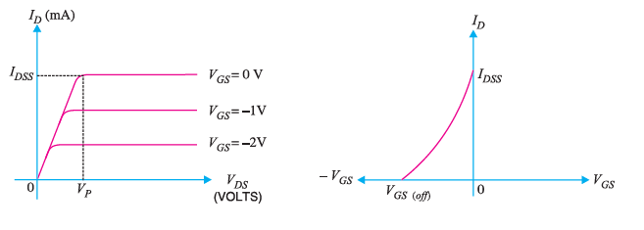
Fig 7

Slide 62
3. Gate-source cut off voltage VGS (off). It is the gate-source voltage where the channel is completely cut off and the drain current becomes zero.
The idea of gate-source cut off voltage can be easily understood if we refer to the transfer characteristic of a JFET shown in Fig. 7. As the reverse gate-source voltage is increased, the crosssectional area of the channel decreases. This in turn decreases the drain current. At some reverse gate-source voltage, the depletion layers extend completely across the channel. In this condition, the channel is cut off and the drain current reduces to zero. The gate voltage at which the channel is cut off (i.e. channel becomes non-conducting) is called gate-source cut off voltage VGS (off). Notes
(i) It is interesting to note that VGS (off) will always have the same magnitude value as VP.
For example if VP = 6 V, then VGS (off) = − 6 V. Since these two values are always equal and opposite, only one is listed on the specification sheet for a given JFET.
(ii) There is a distinct difference between VP and VGS (off). Note that VP is the value of VDS that causes the JEFT to become a constant current device. It is measured at VGS = 0 V and will have a constant drain current = IDSS. However, VGS (off) is the value of VGS that causes ID to drop to nearly zero.

Slide 63

Expression for Drain Current (ID)
The relation between IDSS and VP is shown in Fig. 8. We note that gate-source cut off voltage [i.e.VGS (off)] on the transfer characteristic is equal to pinch off voltage VP on the drain characteristic i.e.

Slide 64
